Slide 1
Linux device driver
Day 5 PPT
-SUBITHRA s

Slide 2
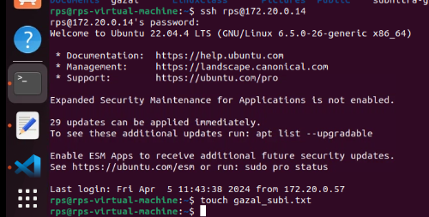
SSH
ssh command stands for Secure Shell, is used to establish a secure and encrypted connection to a remote host or server over a network. It is commonly used for logging into remote machines and executing commands on them securely
Syntax: ssh [user@]host

Slide 3
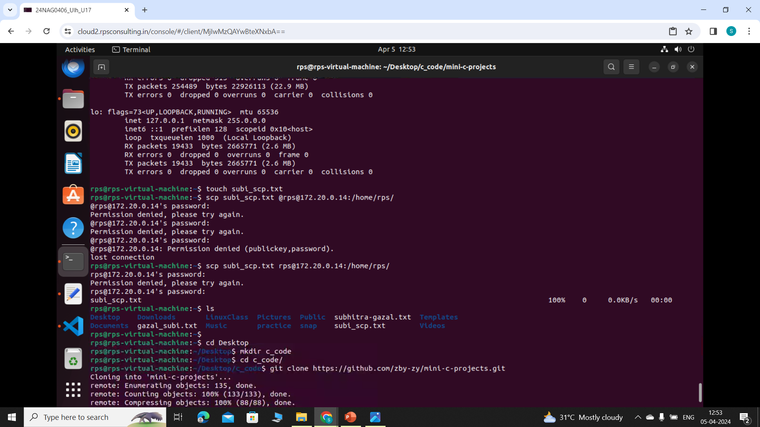
SCP
scp stands for Secure Copy Protocol and is used to securely transfer files between hosts over a network. It works over SSH and provides encryption and authentication capabilities.
Syntax: scp source destination

Slide 4
Shell Scripting
Shell scripting involves writing scripts that are interpreted by a shell, such as Bash, to execute a series of commands.
In a shell script, you can declare variables, read user input, and perform operations based on conditions using if statements.
Loops like for and while allow you to iterate over lists or perform actions repeatedly until a certain condition is met.

Slide 5
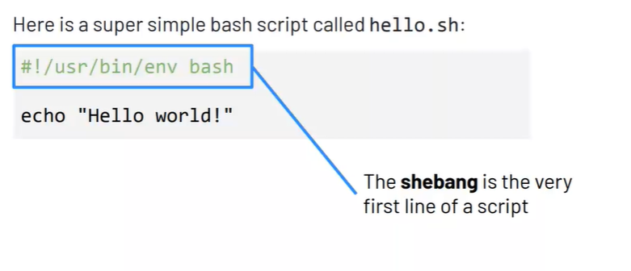

Slide 6
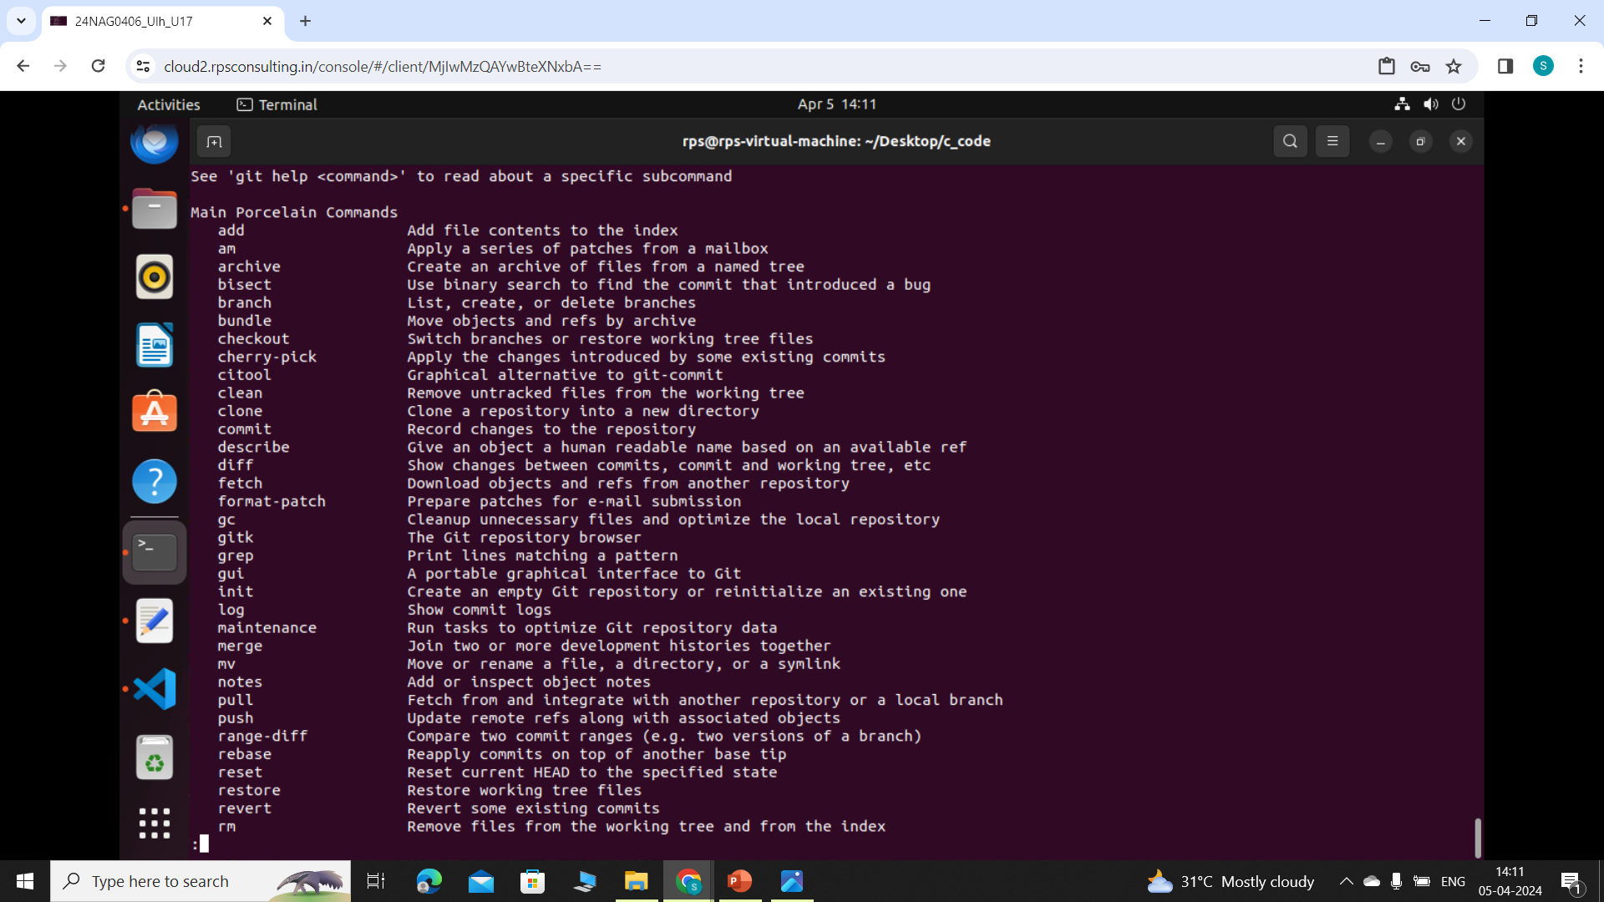
Git manual
Git help -a

Slide 7
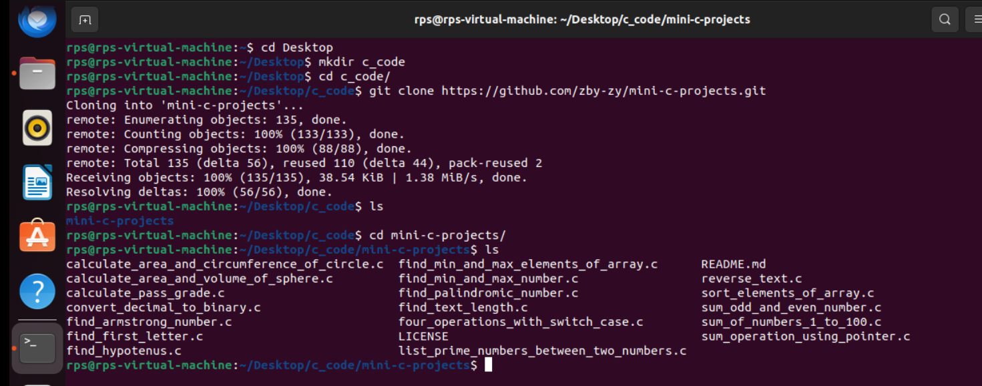
Git clone
The git clone command in Git is used to create a local copy of a remote repository on your machine.
It essentially duplicates the entire repository, including all files, commit history, and branches. This is commonly used for collaborating on projects or contributing to existing codebases.
The basic syntax is git clone <repository_URL>, where <repository_URL> is the URL of the remote repository you want to clone.

Slide 8
Concept | Description | Git Command(s)
Repository | Collection of files and version history | git init, git clone <repository-url>
Commit | Snapshot of changes with a unique identifier | git commit -m "Commit message"
Branch | Separate line of development | git branch, git checkout -b <branch-name>
Merge | Combine changes from one branch into another | git merge <branch-name>
Remote | Version of the repository stored on another machine | git remote add <name> <repository-url>, git push <remote-name> <branch-name>, git pull <remote-name> <branch-name>
Staging Area | Prepare changes before committing to the repository | git add <file>, git add .
Clone | Create a local copy of a remote repository | git clone <repository-url>
Pull | Fetch and merge changes from a remote repository | git pull <remote-name> <branch-name>
Push | Upload commits to a remote repository | git push <remote-name> <branch-name>

Slide 9
THANK YOU

